Slide 1
Cybernetics
DR J BALAMURUGAN

Slide 2
Cybernetics
“Cybernetics” comes from a Greek word meaning "the art of steering".
Cybernetics is about having a goal and taking action to achieve that goal.

Slide 3
Cybernetics
To Know whether you have reached your goal (or at least are getting closer to it) requires feed back a concept that comes from cybernetics

Slide 4
When did cybernetics begin?
Cybernetics as a process operating in nature has been around for a long time.
Cybernetics as a concept in society has been around at least since Plato.
In modern times, the term became widespread because Norbert Wiener wrote a book called "Cybernetics" in 1948.

Slide 5
When did cybernetics begin?
Norbert Wiener sub-title was "control and communication in the animal and machine".
This was important because it connects control (a.k.a., actions taken in hope of achieving goals) with communication (a.k.a., connection and information flow between the actor and the environment).
So, he is pointing out that effective action requires communication.

Slide 6
When did cybernetics begin?
Wiener's also states that both animals (biological systems) and machines (non-biological or "artificial" systems) can operate according to cybernetic principles. This was an explicit recognition that both living and non-living systems can have purpose.

Slide 7
Artificial Intelligence and cybernetics:
Aren't they the same thing?
Researchers in Artificial Intelligence (AI) use computer technology to build intelligent machines; they consider implementation (that is, working examples) as the most important result.
Practitioners of cybernetics use models of organizations, feedback, goals, and conversation to understand the capacity and limits of any system (technological, biological, or social); they consider powerful descriptions as the most important result.

Slide 8
Philosophy of cybernetics
Artificial Intelligence is predicated on the presumption that knowledge is a commodity that can be stored inside of a machine, and that the application of such stored knowledge to the real world constitutes intelligence.
Cybernetics in contrast has evolved from a "constructivist" view of the world where objectivity derives from shared agreement about meaning, and where information is an attribute of an interaction rather than a commodity stored in a computer

Slide 9
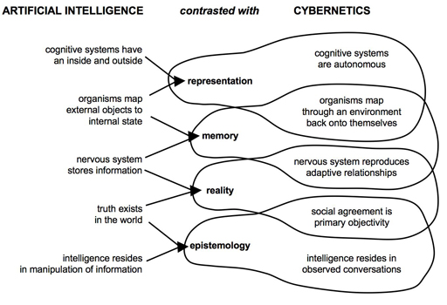

Slide 10
Cybernetics Today
The term "cybernetics" has been widely misunderstood, perhaps for two broad reasons.
First, its identity and boundary are difficult to grasp. The nature of its concepts and the breadth of its applications, as described above, make it difficult for non-practitioners to form a clear concept of cybernetics.
Second, the advent of the prefix "cyb" or "cyber" as a referent to either robots ("cyborgs") or the Internet ("cyberspace") further diluted its meaning, to the point of serious confusion to everyone

Slide 11
Cybernetics Today
The concepts and origins of cybernetics have become of greater interest recently, especially since around the year 2000.
Lack of success by AI to create intelligent machines has increased curiosity toward alternative views of what a brain does and alternative views of the biology of cognition.

Slide 12
Thank you

